Slide 1
Employee Data Analysis using Excel
STUDENT NAME :S.POOJA
REGISTER NO :312209379
NAAN MUDHALVAN ID :ASUNM1353312209379
DEPARTMENT :B.COM GENERAL
COLLEGE :ANNA ADARSH COLLEGE FOR WOMEN

Slide 2
PROJECT TITLE
Employee Performance Analysis using Excel

Slide 3


AGENDA
Problem Statement
Project Overview
End Users
Our Solution and Proposition
Dataset Description
Modelling Approach
Results and Discussion
Conclusion
3/21/2024 Annual Review

Slide 4

PROBLEM STATEMENT
It is about the Employee Performance Analyzer is designed to assess an employee’s current performance level. When an employee exhibits low performance, the tool aids in identifying areas of concern and provides strategies to boost motivation and improve productivity.​

Slide 5

PROJECT OVERVIEW
.
Evaluate employee performance by analyzing multiple factors such as gender and performance ratings, utilizing employee data or a generated performance code​.

Slide 6
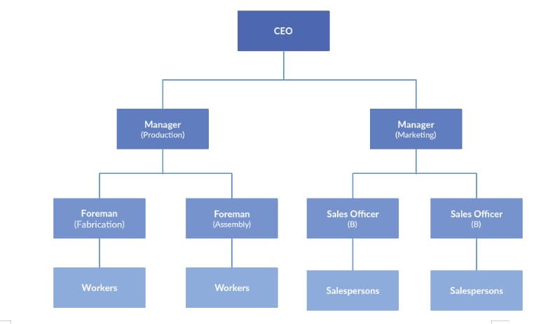

WHO ARE THE END USERS?

Slide 7

OUR SOLUTION AND ITS VALUE PROPOSITION
Using Conditional formatting : Missing figure​
Filter: Remove​
Pivot: Summary ​
Graph: Data Visualization ​

Slide 8
Dataset Description
EMPLOYEE=KARGLE​
26-FEATURES​
9-FEATURES​
EMPLOYEE ID-NUM NAME-TEXT​
EMPLOYEE TYPE​
PERFORMANCE SCORE​
GENDER-Male, FEMALE ​
EMPLOYEE RATING -NUM

Slide 9

THE "WOW" IN OUR SOLUTION
PERFORMANCE=IFS(Z8>=5,”VERY HIGH”,Z8>=4,”HIGH”,Z8>=3,”MED”,TRUE,”LOW”​
3/21/2024 Annual Review
9

Slide 10
MODELLING
1.Data Collection​
a)Downloaded from the Edunet Dashboard.​
b)Gathered the employee performance score​
​
2.Feature Collection:​
a)Identified performance levels.​
b)Removed blank columns.​
​
3.Performance Levels:​
a)Determined performance scores using formulas.​
b)Defined them using a pivot table.​
​
4.Summary:​
a)Downloaded the employee dataset from the dashboard and deleted blank columns.​
b)Created performance levels using formulas.​
c)Defined them with a pivot table.​
10

Slide 11
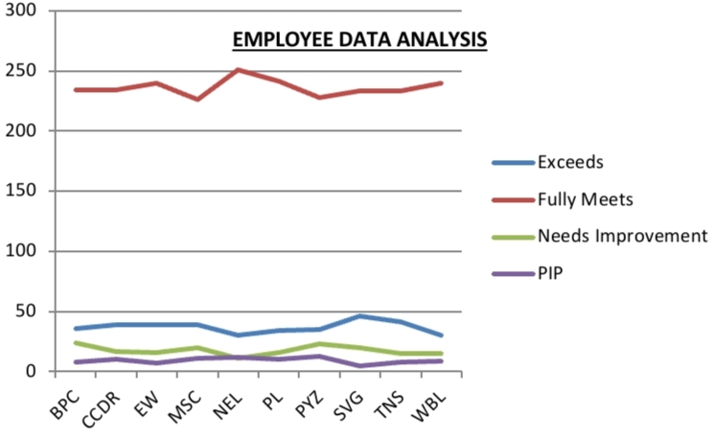
RESULTS
11

Slide 12
conclusion
The employee dataset, as analyzed by me using Excel, shows that the organization is performing well overall. While most employees exhibit good performance, a few need improvement. To help them develop, additional tasks can be assigned. This conclusion highlights the key findings from the dataset.​

